Slide 1
British Airways Analysis of Customer Reviews
Dr José M. Albornoz

Slide 2
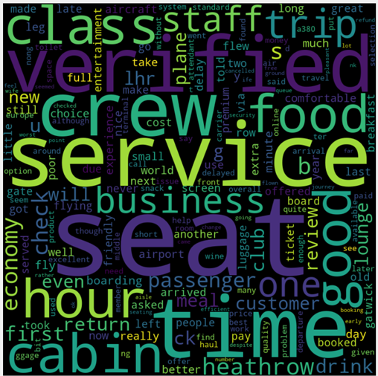
Results of the Analysis
An analysis of 3752 BA customer reviews from Skytrax was performed using AI techniques:
4 main topics were identified in the reviews:
On-board service
Airline operation
Customer service
Flight routes
65.3% of the reviews were classified as negative
34.7% of the reviews were classified as positive
The word cloud on the right shows the most frequent words found in the reviews. The size of each words is associated to their frequency in the reviews.

